Slide 1
EmpowerHer: AI-Powered Mentorship Platform for Women in Tech
Team Name : APT Coders
Team Members : Tanishka Das & Pallavi Dhandar. College Name: Vidyavardhini’s College Of Engineering & Technology.
Notes:
Scenario: Imagine a fast-growing tech company, "TechNova Solutions", that aims to increase diversity and improve mentorship programs for its workforce. Despite implementing mentorship initiatives, the company faces challenges in connecting women employees with suitable mentors, especially those from different cultural, linguistic, or professional backgrounds. Additionally, employees with speech or hearing impairments struggle to participate effectively in mentorship sessions.
To address these issues, TechNova Solutions adopts EmpowerHer, a comprehensive mentorship platform designed to create impactful connections through AI-powered guidance, personalized support, and inclusive features.
Why EmpowerHer: TechNova Solutions faces a talent development gap where women employees struggle to find relevant mentors and guidance. EmpowerHer offers a personalized mentorship platform with secure login, profile management, and career-focused recommendations. Its modern UI ensures ease of use for all employees, making mentorship more accessible and impactful.

Slide 2
Problem
Gender disparity in tech
(Only 28% of women in STEM careers)
Lack of mentorship opportunities
Limited access to personalized guidance
Notes:
EmpowerHer directly addresses these challenges by offering AI-powered mentor matching, sign language translation, and real-time analytics to ensure every employee receives meaningful guidance.

Slide 3
Solution - EmpowerHer
AI-Powered Mentor Matching
Multilingual Chatbot
Meeting Scheduling
Interactive Learning
Feedback System
AI Analytics & Reporting

Slide 4
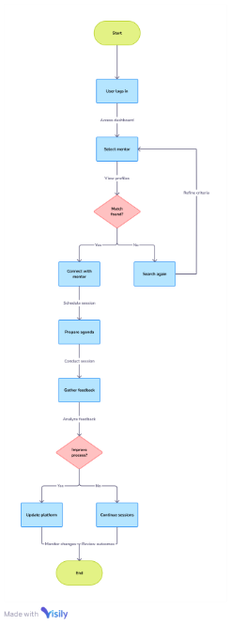
Architecture

Slide 5
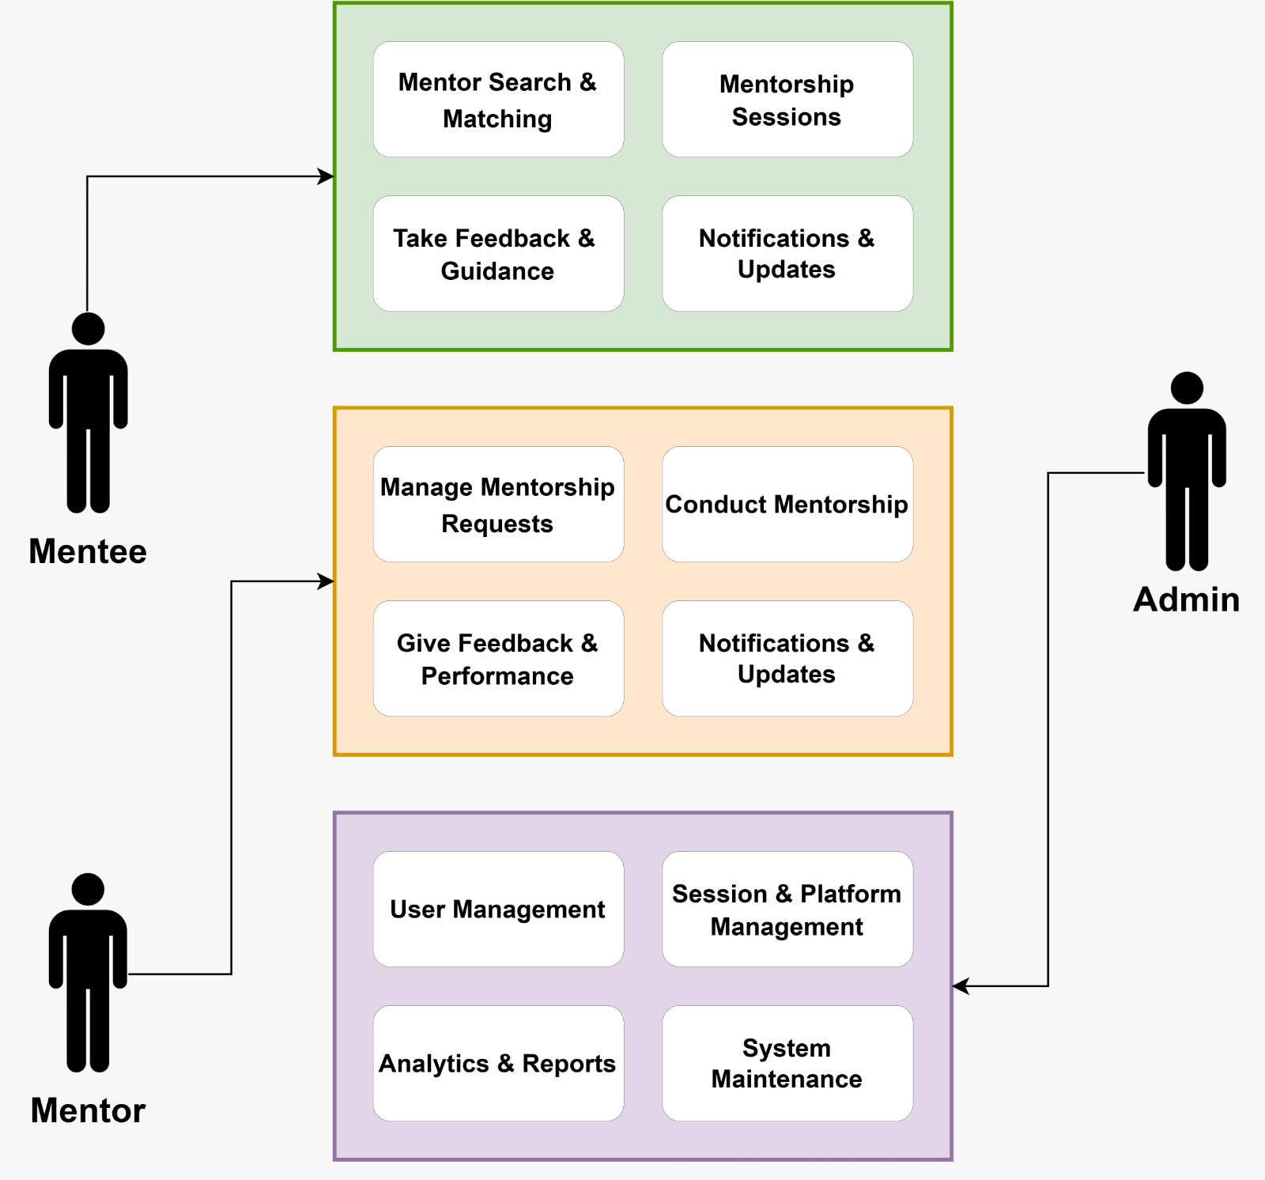

Slide 6










Tech Stack
Backend:
Database:
AI/ML
Realtime Communication:
Frontend:
Notes:
EmpowerHer is built using a robust and scalable tech stack:
React.js with Tailwind CSS delivers a fast, responsive, and user-friendly interface.
Node.js / Django powers the backend for efficient data management and API interactions.
PostgreSQL / MongoDB securely stores user profiles, mentorship data, and session records.
Firebase / WebSockets enable real-time chat and notifications.
Advanced AI features like OpenAI APIs, Google Vision, and Whisper AI enhance communication, accessibility, and analytics.
With WebRTC / Zoom API integration, mentees and mentors can connect through video calls with screen-sharing features.
This scalable architecture allows TechNova Solutions to onboard thousands of employees without compromising performance. Analytics & Insights: Tableau for mentorship data visualization and performance tracking.
Dockerization: The project is containerized using Docker, ensuring consistent environments across development, staging, and production.
Hosting: EmpowerHer is hosted on Vercel, ensuring a seamless CI/CD pipeline with automatic deployment, improved performance, and enhanced security.

Slide 7
Business Impact
Increased women’s participation in tech
Higher career retention & advancement rates
Improved mentorship accessibility & quality
Stronger professional networks & community support
Enhanced diversity & inclusion in tech companies
Better representation of women in leadership roles

Slide 8
✨Thank You🫱🏼‍🫲🏻
Notes:
EmpowerHer is not just a mentorship platform — it’s a strategic investment in diversity, inclusion, and career empowerment. By combining advanced AI features, accessibility tools, and personalized guidance, EmpowerHer empowers organizations to build stronger teams and foster a more inclusive tech ecosystem.
EmpowerHer isn’t just a platform — it’s a movement to inspire, guide, and empower women in tech worldwide. 🌍

Slide 9
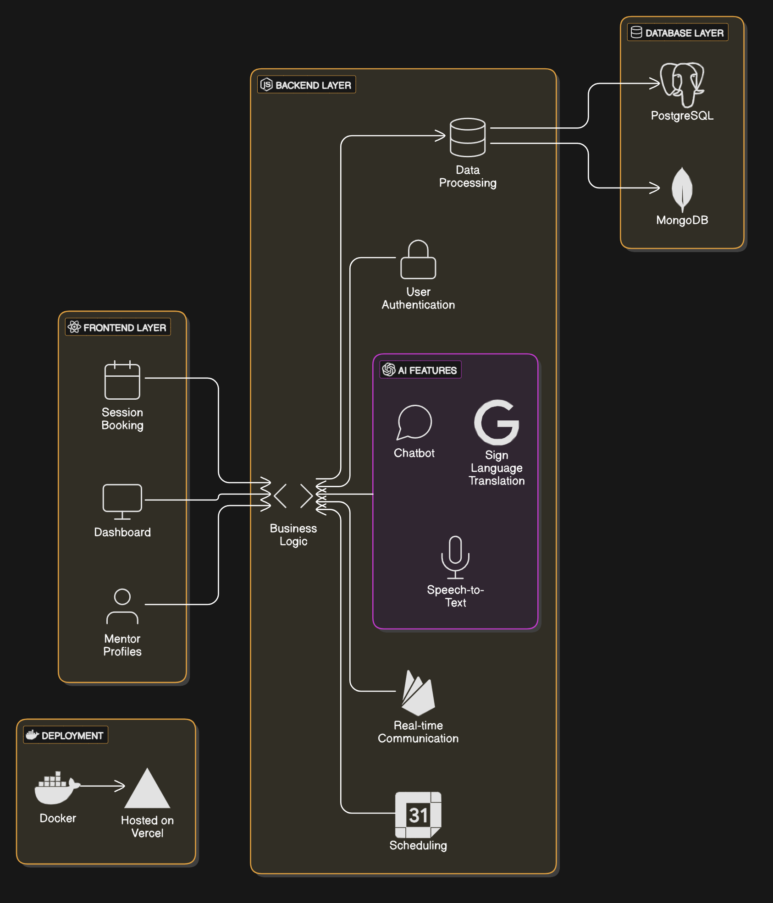

Slide 10
